Slide 1
Using Social Media to Boost Completion and Retention Rates
Rebecca Knapp, MBA
Business Professor Saddleback College Mission Viejo, CA

Slide 2
Please download one of the following:
Vine
Instagram
Flipagram

Slide 3
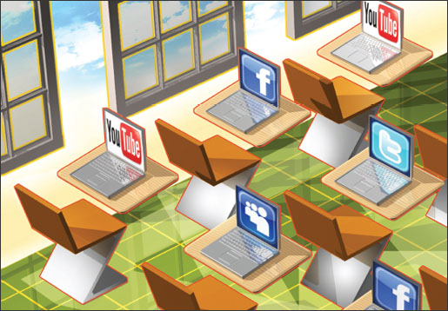
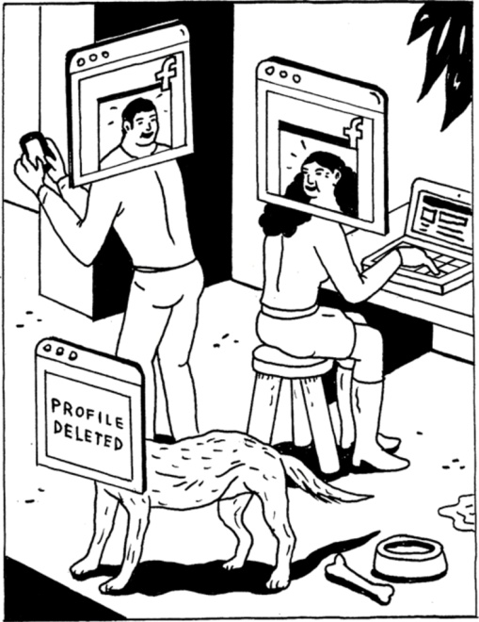
Today’s Key Points
Using Social Media in Higher Education
Social Media Cannot Replace Humanity
Using it Most Effectively
Brainstorming and Experimentation

Slide 4
The Argument For Using Social Media
Key Point #1

Slide 5
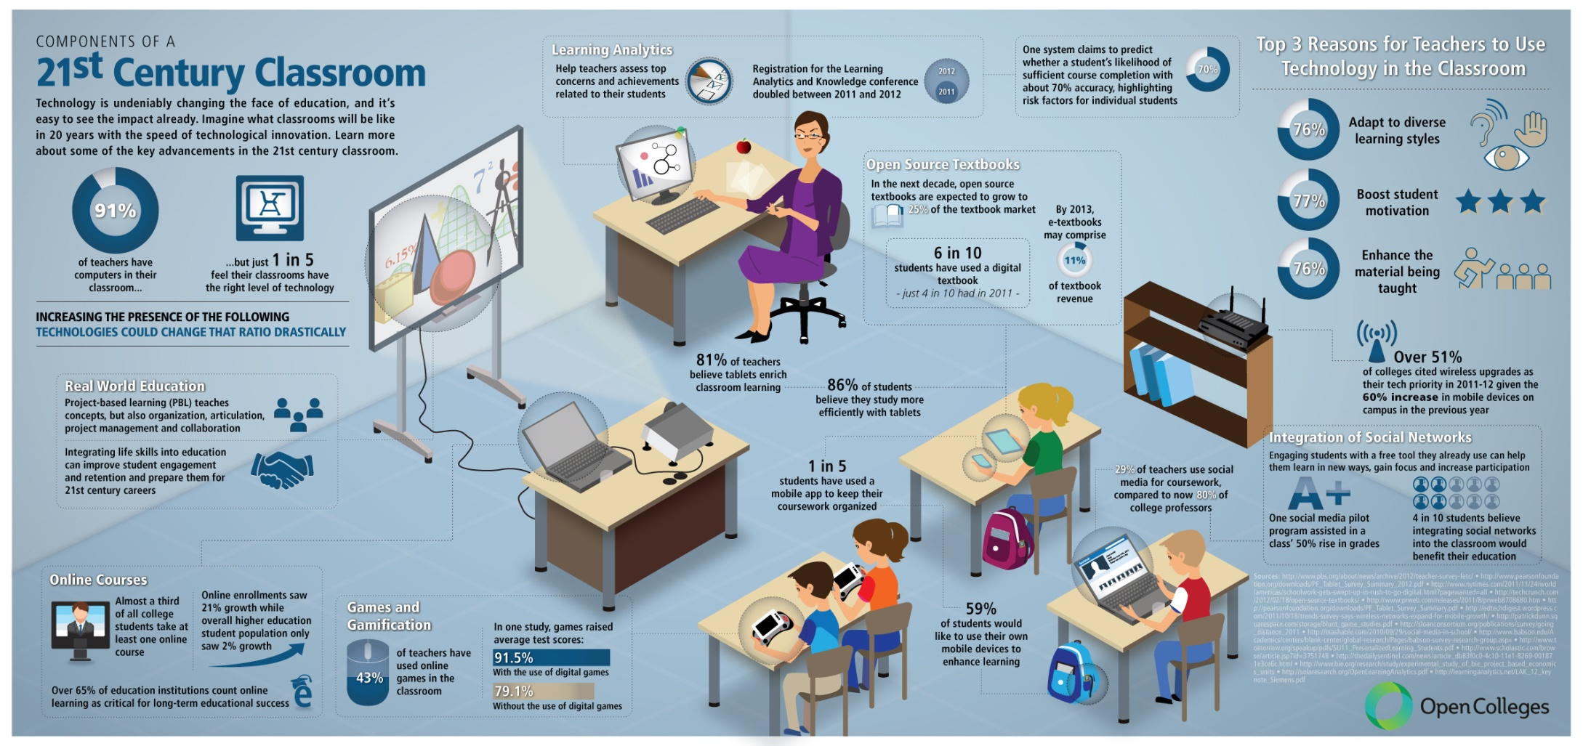

Slide 9
Why Use Social Media?
Students communicate, research, collaborate, create and publish online with or without the help of parents or educators.
Students then use social media to promote, discuss and share their thoughts with the world.
The quietest students in class speak the loudest on social media.
The digital environment is offering us some of the greatest learning opportunities that young learners have ever had.

Slide 10
Student Survey
What do their digital lives look like?

Slide 11
Student Survey
97%
73%
48%
32%

Slide 12
Student Survey

Slide 13
Student Survey
They used to ask us to leave SnapChat to them. Now, they’re asking us to be there.
They’re on Skype… Why not online office hours?
They’re increasingly on Twitter… Why not us, too?
Equally on LinkedIn… Are you connected to your students?
They love Pinterest (esp. girls)… Are you sharing resources?
They like Vines… They just think it’s too hard to make them.
They hate podcasts.
They don’t think professors are on social media.

Slide 14
64%
➔ 73%
I like it when my professors use social media to supplement class content.

Slide 15
54%
➔ 55%
I expect a face-to-face classes to have online components (Blackboard, Facebook group, etc.) to supplement our in-class experience.

Slide 16
50%
➔ 53%
I like to connect online with my professors.

Slide 17
43%
➔ 46%
I like to connect online with classmates.

Slide 18
45%
➔ 62%
I feel social media enhances my learning experience.

Slide 19
22%
➔ 11%
I feel sometimes professors use technology more for the sake of technology than for my benefit.

Slide 20
8%
➔ 16%
There is already too much technology in my life. I don't need my professor using it, too.

Slide 21
31%
➔ 14%
I think professors know less about technology than I do.

Slide 22
Student Survey

Slide 23
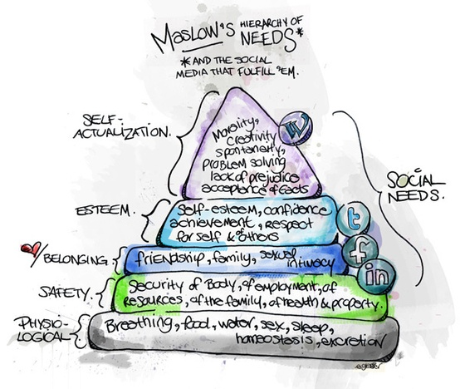
Wi-Fi

Slide 24
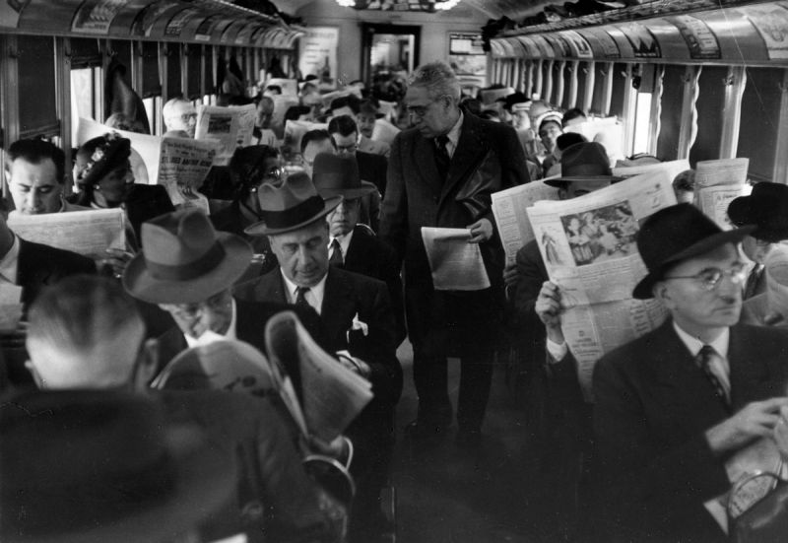

Slide 25
Social Media Cannot Replace Humanity
Key Point #2

Slide 26
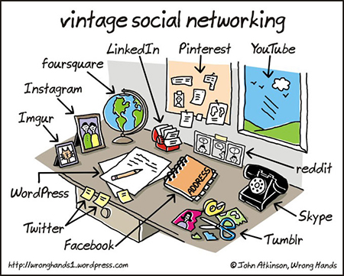

Slide 27
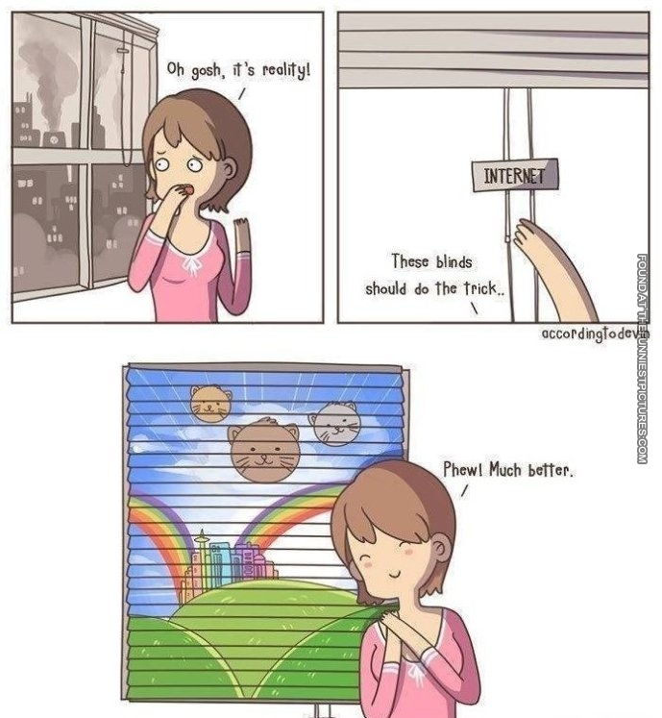

Slide 28
There’s No App for Good Teaching
Keep learning goals ahead of the technology.
Opt for the open-ended.
Don’t let tech make learning easy.
Take feedback seriously.
Stay skeptical of individualized learning.
Bring in student interests, authentically.
Start conversations.
Make it open, make it better.
Source: http://ideas.ted.com/2014/09/03/theres-no-app-for-good-teaching/

Slide 29
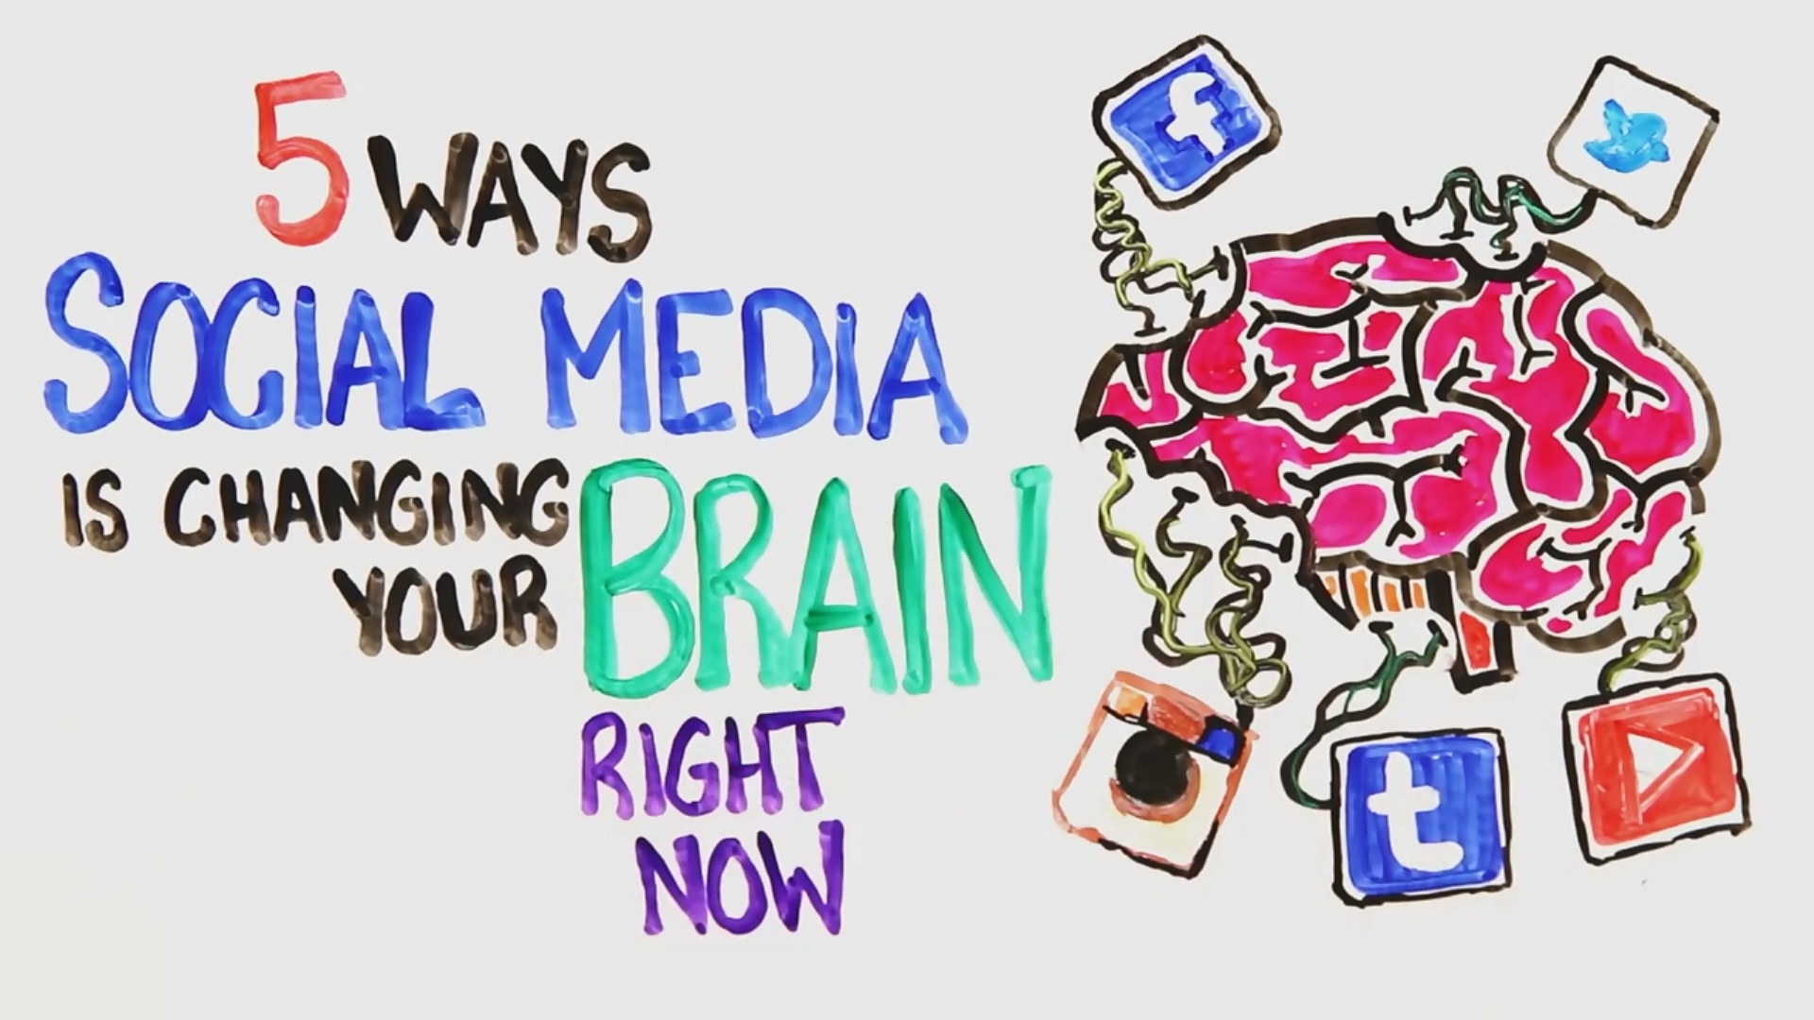
Can’t Replace Humanity, But it CAN Simulate It

Slide 30
Using it Most Effectively
Key Point #3

Slide 32
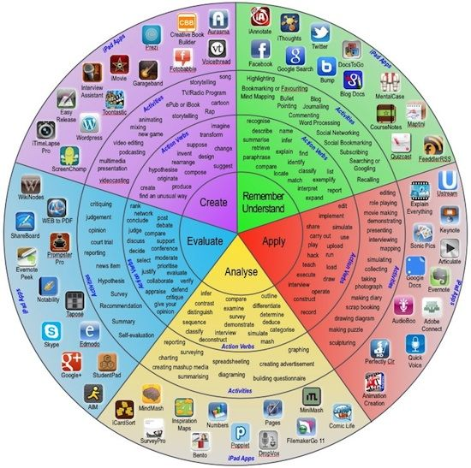
Bloom’s Taxonomy of Social Media

Slide 34
20 Most Popular Social Media Sites

Slide 36
What is YOUR brand?

Slide 37
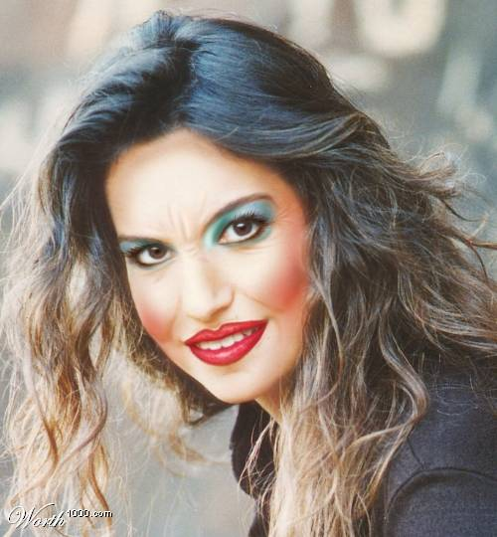
You’re Doing It Wrong
Right!
Have a tone or personality
Keep it consistent
Choose your platforms
Stick to them
Be authentic
The know when we’re trying too hard
Everything in moderation
You’re competing for their :06
They will tune you out

Slide 38
What I Use

Slide 39
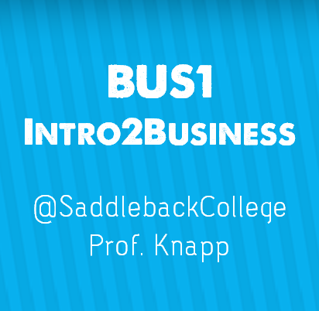
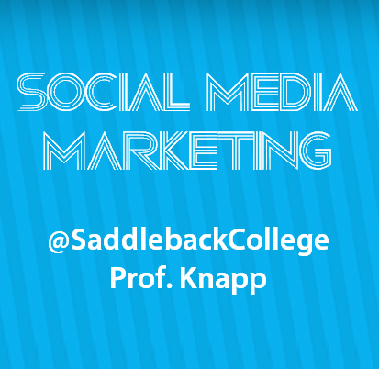
Using Social Media for Education
Facebook
Major or extracurricular Groups
Create project “Events”
Like all relevant Pages
Follow major thought leaders
Use #hashtags and @s to join the global conversation

Slide 40
Using Social Media for Education
Twitter
#yourclassname
Follow college departments and organizations
Follow companies and #internships
140 character resume and #hireme
Run a class project using a unique hashtag

Slide 41
Using Social Media for Education
Relevant boards
Study Tips
Surviving Final Exams
Motivational/Inspirational Quotes
Create Study Boards
Pinterest.com/Knapp0606

Slide 42
Using Social Media for Education
Blogs
Share quick reminders
Spark the conversation
Bring the conversation to the classroom
Clarify details quickly

Slide 44
Using Social Media for Education
Skype
Engage the distant
Connect to the real world
Host guests
Connect with online students
Online Orientations

Slide 45
Using Social Media for Education
Skype
Interject value in their feed
Share relevant current events
Infuse reminders in their distraction
Choose a genre or topic
“Hunting Help Wanted Signs”

Slide 46
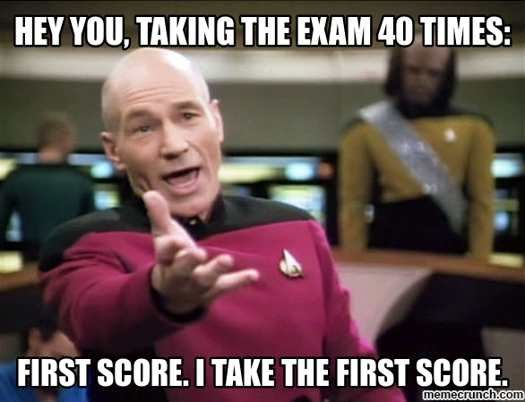
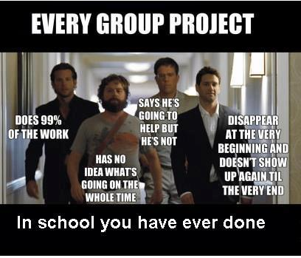
Using Social Media for Education
Memes
Use humor to make a point
Connect to imagery they relate to

Slide 48
The Digital Media Exit Card
A six-second Vine video to capture the most critical six seconds of class
A 16-second video to post to MixBit, YouTube's new video sharing tool
A tweet that boils down the essence of the class to 140 characters
A photo illustrating the key learning moment that can then be posted on a class Instagram account
A collage video using Flipagram to convey what a team learned in a group project.
A question posted to a class Facebook account inviting a continuation of the learning outside of class

Slide 49
More Tools:
www.KnappBiz.com

Slide 50
Let’s Experiment!

Slide 51
Thank you for listening!
Rebecca Knapp, MBA
Business Professor Saddleback College
www.KnappBiz.com

Slide 52
Sources
"7 Tips for Using Social Media - Teach Amazing!." Teach Amazing. N.p., n.d. Web. 8 Oct. 2014. <http://teachamazing.com/7-tips-for-using-social-media/>.
"Hit the Mark with Digital Media Exit Cards." Edutopia. N.p., n.d. Web. 8 Oct. 2014. <http://www.edutopia.org/blog/digital-media-exit-cards-matt-levinson?utm_source=twitter&utm_medium=post&utm_campaign=blog-exittickets-fb-image>.
"How to Use Social Media for Your Education." College Fashion. N.p., n.d. Web. 8 Oct. 2014. <http://www.collegefashion.net/college-life/how-to-use-social-media-for-education/>.
"Should teachers be using social media in the classroom?." PBS. PBS, n.d. Web. 8 Oct. 2014. <http://www.pbs.org/newshour/updates/social-media-valuable-tool-teachers/>.
"Six Ways to Use Social Media in Education." Center for Instructional Technology. N.p., n.d. Web. 8 Oct. 2014. <http://cit.duke.edu/blog/2012/04/six-ways-to-use-social-media-in-education/>.
"Social Media and Digital Skills in Higher Education." Social Media and Digital Skills in Higher Education. N.p., n.d. Web. 8 Oct. 2014. <http://www.slideshare.net/suebeckingham/social-media-and-digital-skills-in-higher-education>.
Created using:

