Slide 1
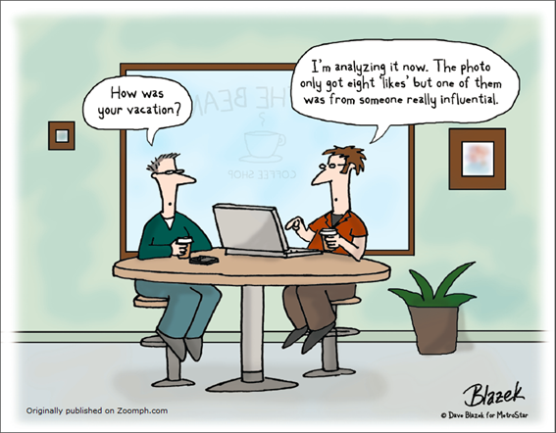

Slide 2
Using Social Media to Boost Completion and Retention Rates
Rebecca Knapp, MBA
Business Professor
Saddleback College
Mission Viejo, CA

Slide 3
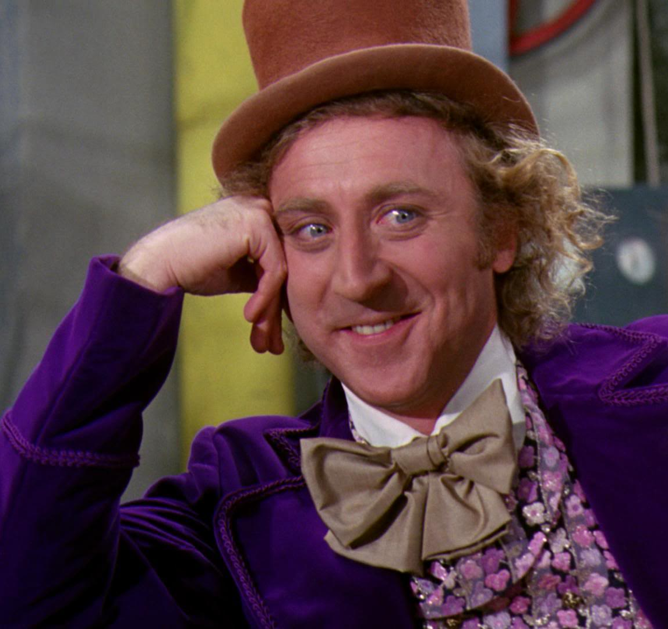
What Makes Me Qualified?
Professional Background
  15 years in corporate communications and marketing
Teaching Experience
  4 years at HS
  12 years at CCs
  Develop Social Media
  Marketing Curriculum
SO TELL ME…
DO YOU THINK YOU’RE INTELLIGENT
IF YOU SAY SMART WORDS?

Slide 4
Today’s Key Points
Using Social Media in Higher Education
Social Media Cannot Replace Humanity
Using Social Media Most Effectively

Slide 5
The Argument For Using Social Media
Key Point #1

Slide 6
The Argument for Social Media in Higher Education
Assortment of tools
Mix and Match
Suits individual learning styles
Increases academic success
Source: Grover, A., & Stewart, D. W. (2010). Defining interactive social media in an educational context. In C. Wankel & M. Marovich & J. Stanaityte (Eds.), Cutting edge social media approaches to business education: Teaching with LinkedIN, Facebook, Twitter, Second Life, and Blogs (pp7-38). Charlotte, NC: Information Age Publishing.

Slide 7
Why Use Social Media?
Students communicate, research, collaborate, create and publish online with or without the help of parents or educators.
Students then use social media to promote, discuss and share their thoughts with the world.
The quietest students in class speak the loudest
on social media.
The digital environment is offering us some of the greatest learning opportunities that young learners have ever had.

Slide 8
Students on Social Media
What do their digital lives look like?

Slide 9
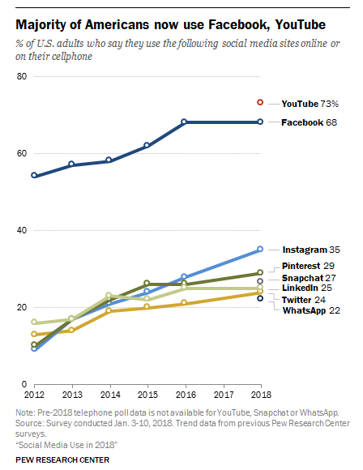
Source: http://www.pewinternet.org/2018/03/01/social-media-use-in-2018/

Slide 10
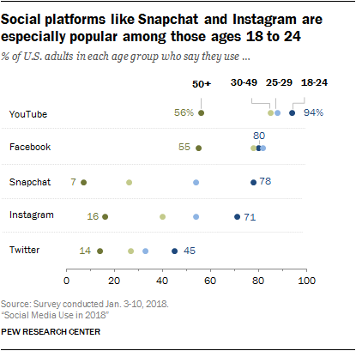
A sizeable majority of these users (71%) visit Snapchat multiple times per day.

Slide 11
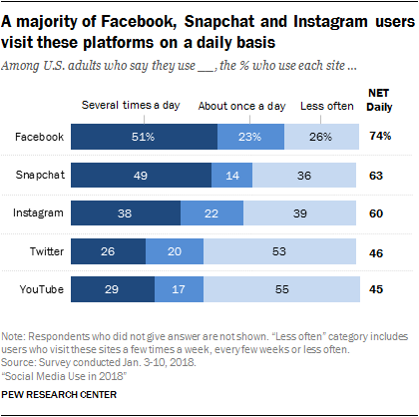

Slide 12
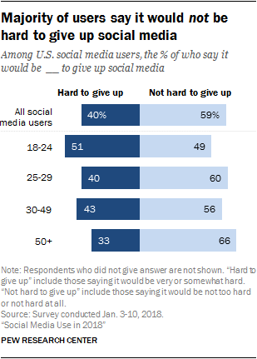

Slide 13
Americans on Social Media
68% of U.S. adults are now Facebook users
  Besides YouTube, no other platforms are used by >40%
Instagram is growing: 35% of U.S. adults are IG users
  28% in 2016
18- to 29-year-olds: 88% use any form of social media
  30- to 49-year-olds: 78%
  50- to 64-year-olds: 64%
  65+-year-olds: 37%

Slide 14
Americans on Social Media
Pinterest remains substantially more popular with women
  (41% of whom say they use the site) than with men (16%).
LinkedIn remains especially popular among college graduates and those in high-income households.
  50% of Americans with a college degree use LinkedIn
  Just 9% of those with a high school diploma or less.
WhatsApp (messaging service) is popular in Latin America and Latinos in the United States
  49% of Hispanics report that they are WhatsApp users
  Compared with 14% of whites and 21% of blacks

Slide 15
Student Survey
They used to ask us to leave SnapChat to them.
Now, they’re asking us to be there.
They’re on Skype… Why not online office hours?
They’re increasingly on Twitter… Why not us, too?
Equally on LinkedIn… Are you connected to your students?
They love Pinterest (esp. girls)… Are you sharing resources?
They don’t consistently check their email… Avoid assuming.
They are constantly texting… Do you use Remind? Nudges?
They hate podcasts.
They don’t think professors are on social media.

Slide 16
64%
➔ 73%
I like it when my professors use social media to supplement class content.

Slide 17
54%
➔ 55%
I expect a face-to-face classes to have online components (Canvas, Facebook group, YouTube Channel, etc.) to supplement our in-class experience.

Slide 18
50%
➔ 53%
I like to connect online with my professors.

Slide 19
43%
➔ 46%
I like to connect online with classmates.

Slide 20
45%
➔ 62%
I feel social media enhances my
learning experience.

Slide 21
22%
➔ 11%
I feel sometimes professors use technology more for the sake of technology than for my benefit.

Slide 22
8%
➔ 16%
There is already too much technology in my life. I don't need my professor using it, too.

Slide 23
31%
➔ 14%
I think professors know less about
technology than I do.

Slide 24
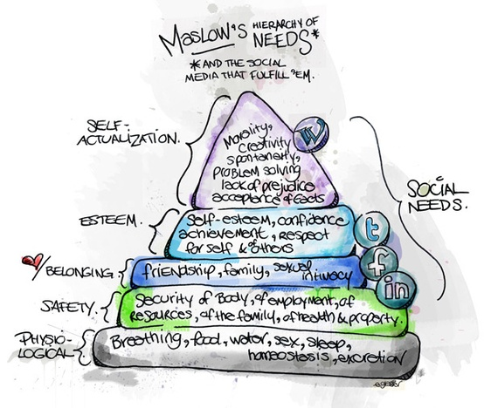
Wi-Fi

Slide 25
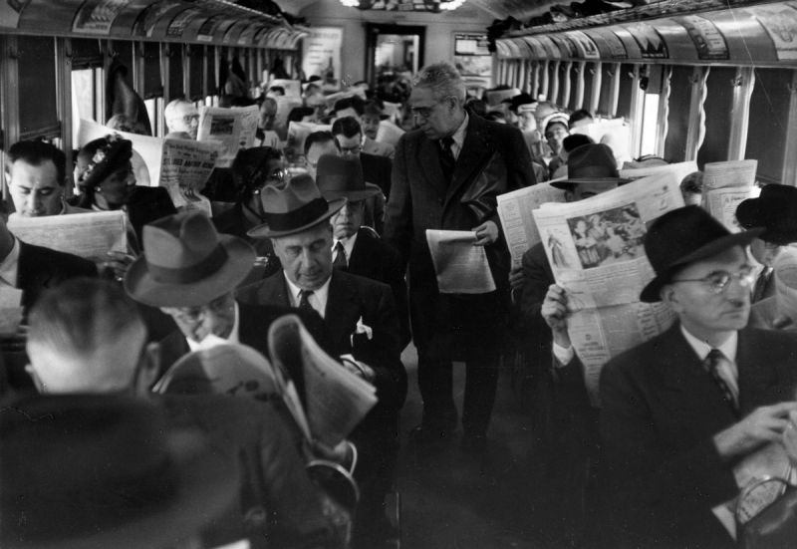

Slide 26
Social Media Cannot Replace Humanity
Key Point #2

Slide 27
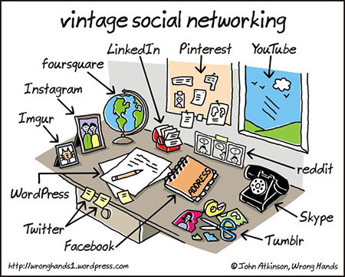

Slide 28
There’s No App for Good Teaching
Keep learning goals ahead of the technology.
Opt for the open-ended.
Don’t let tech make learning easy.
Take feedback seriously.
Stay skeptical of individualized learning.
Bring in student interests, authentically.
Start conversations.
Make it open, make it better.
Source: http://ideas.ted.com/2014/09/03/theres-no-app-for-good-teaching/

Slide 29
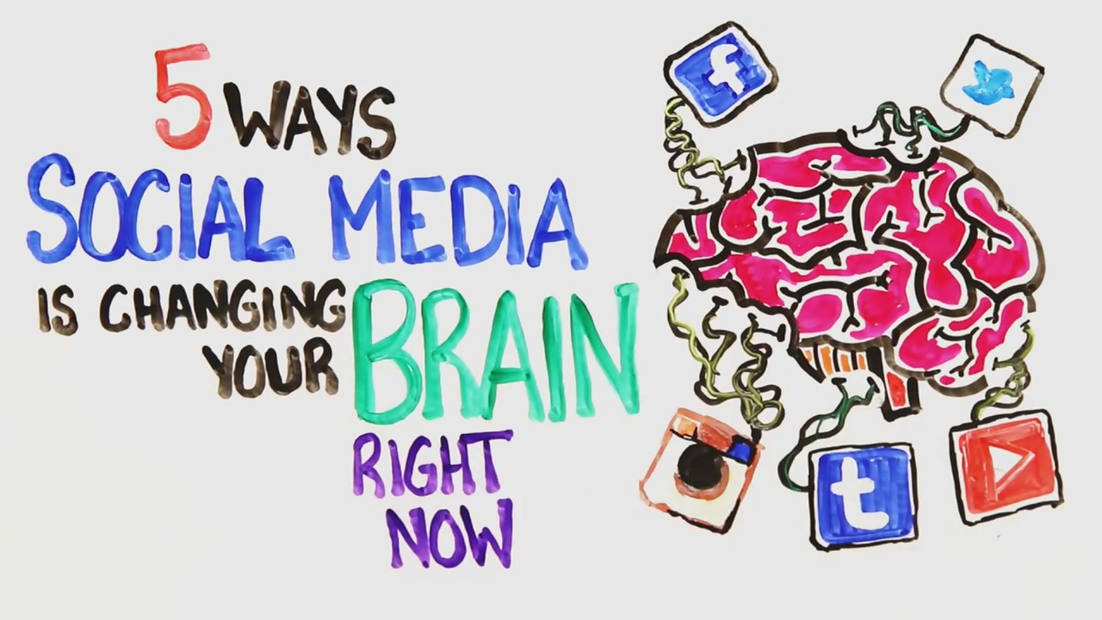
Can’t Replace Humanity,
But it CAN Simulate It

Slide 30
Using it Most Effectively
Key Point #3

Slide 31
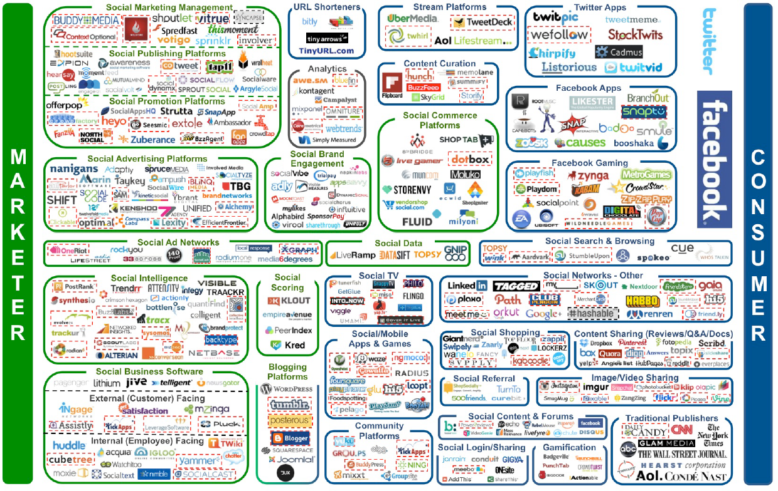

Slide 32
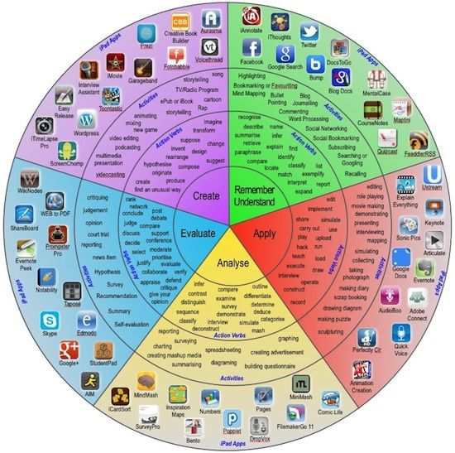
Bloom’s Taxonomy of Social Media

Slide 33


Slide 34


Slide 35


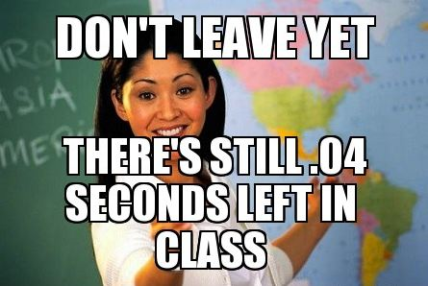
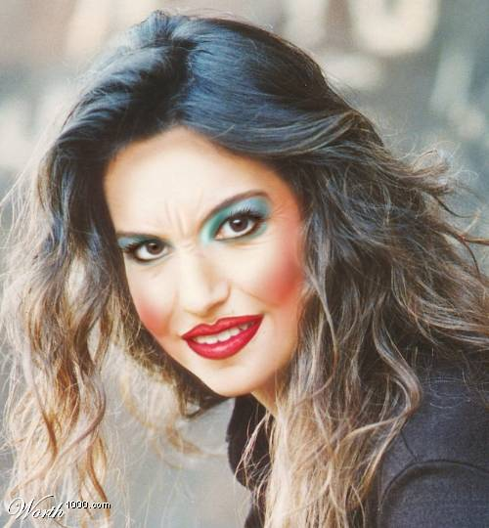
You’re Doing It Wrong
Right!
Have a tone or personality
  Keep it consistent
Choose your platforms
  Stick to them
Be authentic
  The know when we’re trying too hard
Everything in moderation
  You’re competing for their :06
  They will tune you out

Slide 36







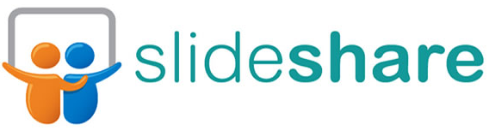





What I Use

Slide 37

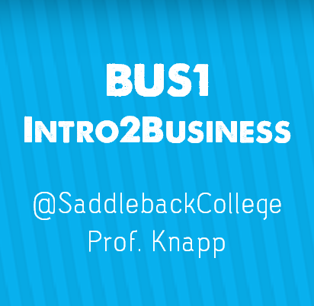
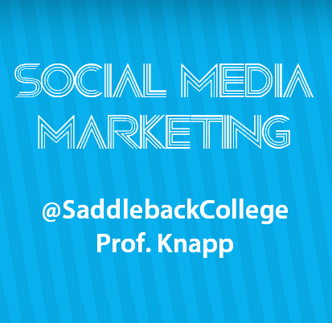
HOW to Use Social Media for Education
  Major or extracurricular Groups
  Create project “Events”
  Like all relevant Pages
  Follow major thought leaders
  Use #hashtags and @s to join the global conversation
  Go Live with Relevant Updates or Tips

Slide 38


HOW to Use Social Media for Education
Twitter
  #yourclassname
  Follow college departments and organizations
  Follow companies and #internships
  140 character resume and #hireme
  Run a class project using a unique hashtag

Slide 39

HOW to Use Social Media for Education
  Relevant boards
  Study Tips
  Surviving Final Exams
  Motivational/Inspirational Quotes
  Create Study Boards
www.pinterest.com/knapp0606

Slide 40

HOW to Use Social Media for Education
  Share quick reminders
  Spark the conversation
  Share daily news or events
  Bring the conversation to the classroom
  Clarify details quickly

Slide 41
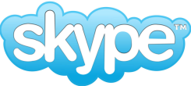

HOW to Use Social Media for Education
Skype
  Engage the distant
  Connect to the real world
  Host guests
  Connect with online students
  Online Orientations

Slide 42


HOW to Use Social Media for Education
Skype
  Interject value in their feed
  Share relevant current events
  Infuse reminders in their distraction
  Choose a genre or topic
    “Hunting Help Wanted Signs”

Slide 43


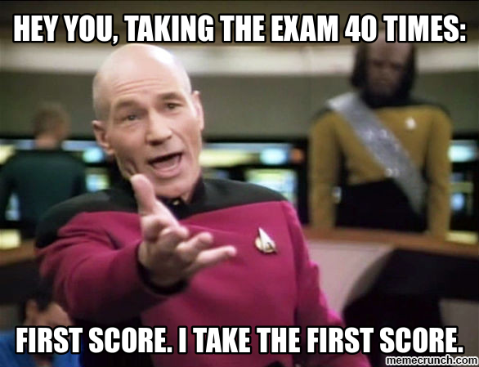
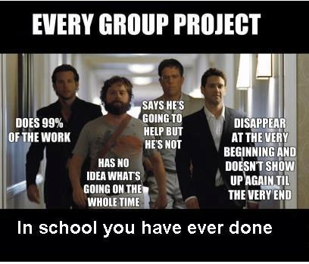
Memes
Memes
  Use humor to make a point
  Connect to imagery they relate to

Slide 44


Slide 45
Digital Media Exit Card
Have students create a six-second video to capture the most critical point in class, Remind it to you
A 16-second video to post to MixBit, YouTube's video sharing tool
A tweet that boils down the essence of the class to 140 characters
A photo illustrating the key learning moment that can then be posted on a class Instagram account, #Topic
A collage video using Flipagram to convey what a team learned in a group project
A question posted to a class Facebook account inviting a continuation of the learning outside of class
PicStitch visuals supporting a course’s lecture topic.

Slide 46
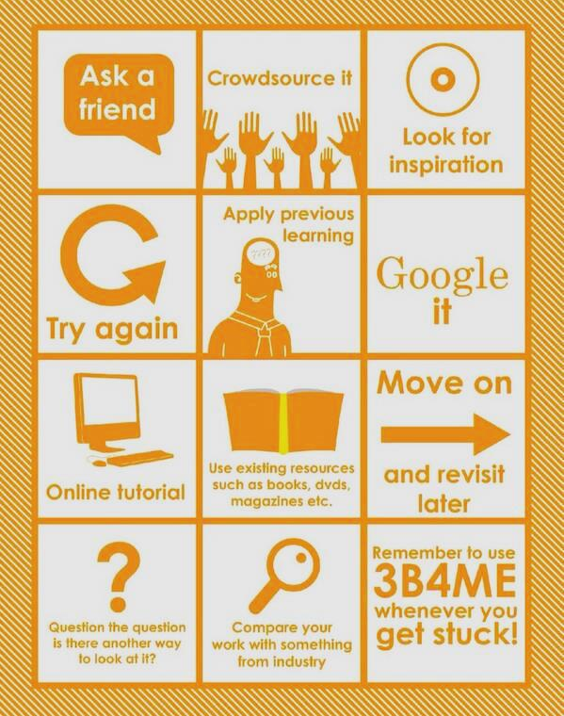
3-B4-ME

Slide 47
More Tools:
www.KnappBiz.com/social-media

Slide 48

Sources
"7 Tips for Using Social Media - Teach Amazing!." Teach Amazing. N.p., n.d. Web. 8 Oct. 2014. <http://teachamazing.com/7-tips-for-using-social-media/>.
"Hit the Mark with Digital Media Exit Cards." Edutopia. N.p., n.d. Web. 8 Oct. 2014. <http://www.edutopia.org/blog/digital-media-exit-cards-matt-levinson?utm_source=twitter&utm_medium=post&utm_campaign=blog-exittickets-fb-image>.
"How to Use Social Media for Your Education." College Fashion. N.p., n.d. Web. 8 Oct. 2014. <http://www.collegefashion.net/college-life/how-to-use-social-media-for-education/>.
"Should teachers be using social media in the classroom?." PBS. PBS, n.d. Web. 8 Oct. 2014. <http://www.pbs.org/newshour/updates/social-media-valuable-tool-teachers/>.
"Six Ways to Use Social Media in Education." Center for Instructional Technology. N.p., n.d. Web. 8 Oct. 2014. <http://cit.duke.edu/blog/2012/04/six-ways-to-use-social-media-in-education/>.
"Social Media and Digital Skills in Higher Education." Social Media and Digital Skills in Higher Education. N.p., n.d. Web. 8 Oct. 2014. <http://www.slideshare.net/suebeckingham/social-media-and-digital-skills-in-higher-education>.
“Social Media Use 2018: Demographics and Statistics.” Pew Research Center. Aaron Smith-Monica Anderson. 7 Oct. 2018. <http://www.pewinternet.org/2018/03/01/social-media-use-in-2018
Created using:

Slide 49
Thank you for coming!
Rebecca Knapp, MBA
Business Professor
Saddleback College
www.KnappBiz.com

